Slide 1
From Erasure to Revitalization
Essential Questions:
How does erasure impact communities?
Who should tell our stories, and why does it matter?

Slide 2
Lesson 4: Assimilation and Resistance

Slide 3
Vocabulary
assimilate: to become absorbed and integrated into a society or culture.
resistance:the refusal to accept or comply with something; the attempt to prevent something by action or argument.

Slide 4
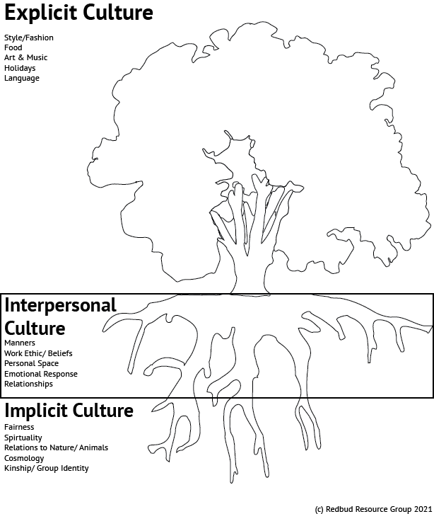
On the top: list the parts of your culture or identity that are visible
In the middle: list the parts of your culture/identity that are related to communication, work ethic, and conflict resolution
On the bottom: List the parts of your culture/identity related to your spirituality, worldview, and concept of self
Warm Up:

Slide 5
Assimilation and Resistance in California Native communities

Slide 6
Example Legislation Meant to Assimilate or Eliminate Native Peoples
CA Tribal Termination
1950’s
Boarding School Era
1879-1973
Unratified Treaties
1851
Act for the Governance
& Protection of Indians
1850
Gold Rush Begins
1849
California Mission System
1769-1833
Discovery Doctrine
1493
Notes:
Discovery Doctrine- . Columbus, during his travels, was granted permission by the Spanish monarchy to seize any land that was not already controlled by Christian rulers. Many letters and essays were exchanged between monarchs and the pope during this time, laying out the philosophy behind Christian conquest. These documents make up a legal doctrine through which Western nations rationalized the colonization of non christian lands, in often violent and forceful ways. The Discovery Doctrine was enshrined in US law during the supreme court case Johnson vs. McIntosh, in which Justice Marshal states that christians took their rightful dominion over the non christian “heathens”. This decision brought the idea of Indigenous sovereignty, the idea that Native people have the right to control their own communities and land) into question.
California Mission System Beginning in 1769, Spanish missionaries began building a series of 21 missions along the coast of California. Native communities were forcibly placed in missions, where they baptized, forced into labor camps, and were not allowed to leave the missions. Natives were forced to give up their languages, traditional dress, and religious and marriage customs. Thousands died from disease. In total, over 80k Natives were baptized. Even so, Native communities rebelled against the missions, and even burned some down.
California Gold Rush 1848-1860- After the Treaty of Hidalgo was signed in 1848, gold was discovered in California’s foothills. Over 90k settlers entered California in the first year and a half of the gold rush. Settlers were incredibly violent against Native people during this time, and their mining practices damaged the land, waterways,and cultural resources in the region. As miners build cities and ranches, many Native people were taken into servitude, experienced sexual and physical violence, and were forcibly removed from their land.
Act for the Governance and Protection of Indians- An act that legalized and incentivized the forced indentured servitude of Native people to white settler families. At the time, Native people did not have their citizenship, could not vote, and could not testify in court. The act led to increased violence against Native people, which eventually led to a state sanctioned genocide, where settlers were paid by the California government to murder Native people.
Unratified Treaties- California’s 18 Unratified Treaties are a series of agreements made between government officials and tribal leaders, that promised Native communities large swaths of reservation lands, based on the reservations in the plains. Out of concern for giving away land that could be economically lucrative, the federal government chose not the ratify the treaties, and so they never went into effect. Without notifying tribal leaders, tribes were left landless, destitute, and with little to no government protection.
Boarding school era-1870’s-1880’s (ended in California) 1978 (ended nationally) A nation-wide campaign to assimilate Native children into settler culture by removing them from their families, forbidding the use of their Native languages or cultures, and indoctrinating them into Christianity. Many children died or never returned home, and those who did were often culturally distanced from their families. The impacts of this system are still felt today, as cultural loss, and parenting challenges are still present. The system ended nationally in 1978 with the passing of the Indian Child Welfare Act, which gave Natives jurisdiction over issues related to child welfare.
Tribal termination- Called for the end of welfare assistance guaranteed to government-recognized Native peoples through the treaty process, and allowed for the private purchasing of once protected Native land to non Native individuals. When Native communities “accepted termination”, Native communities lost access to education, health care, and their property tax exemption status. Without this tax exempt status, many impoverished Native communities ended up defaulting on their tax payments. While the government originally saw this as an opportunity to take control of Native property, it quickly became a burden on resources. In the end, the government convinced 36 tribes to accept tribal termination, and was able to acquire 5k+ acres of Native land, leaving those tribal communities with little to no government protections.

Slide 7
Assimilation and Resistance in
CA Native Communities
Why have Native people assimilated throughout history?
What examples of assimilation do you see in this video?
What examples of resistance do you see?
Notes:
https://www.youtube.com/watch?v=qYgZ1Pxw6aI

Slide 8
Where do you see assimilation in this photo?
Where do you see resistance?
Cloverdale Rancheria of Pomo Indians
Notes:
http://www.cloverdalerancheria.com/

Slide 9
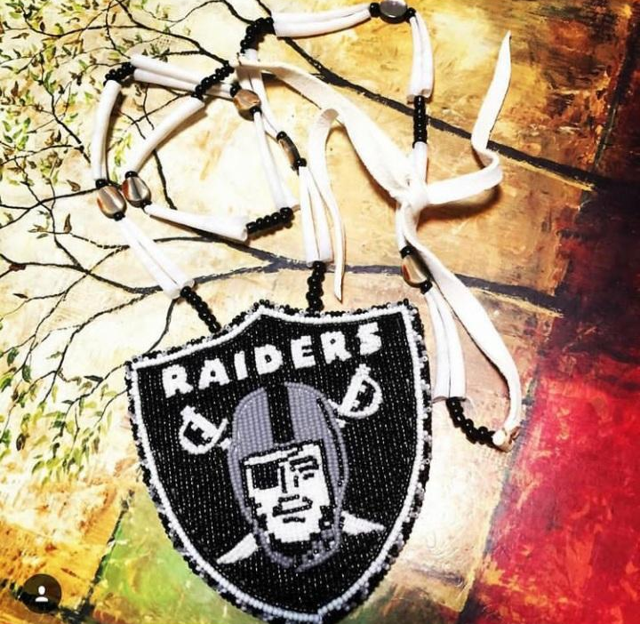
Where do you see assimilation in these examples?
Where do you see resistance?
Artist: Robin Meely
Pomo, Coast Miwok, and Navajo
Artist: Rudy Hammock Jr.
Pomo, Wailacki, and Maidu
Artist: Christy Carrillo Carr
Pomo

Slide 10
How does assimilation contribute to cultural erasure?
Can assimilation and resistance exist at the same time?

Slide 11
Poetry Analysis:
“Lies my Ancestors Told For Me”
By Deborah Miranda

Slide 12
Poetry Analysis: Lies my Ancestors Told For Me
Directions: Annotate “Lies My Ancestors Told For Me” by Deborah Miranda, answering the following questions:
Do you notice the impact of any specific assimilation movements or policies in the poem?
How does the poet’s family protect themselves from violence?
In what ways do they choose to assimilate? In what ways do they protect their culture?
What does the title of the poem mean?
Choose a line from the poem that stands out to you and share it with your neighbor or class

Slide 13
Narrator Cultural Iceberg
Directions: Create a cultural iceberg diagram for the narrator of the poem, listing the visible parts of their identity and culture on the top, and the less visible parts on the bottom.

Slide 14
Wrap Up:
What are some ways that marginalized communities might protect themselves against erasure?
How does this help the community survive? How does it contribute
to cultural erasure?

Slide 15
Standards and Takeaways
Key Takeaway: Native communities are diverse, modern, geographically spread out, and political in nature.
Common Core:
CCSS.ELA-LITERACY.RI.9-10.7
Analyze various accounts of a subject told in different mediums (e.g., a person's life story in both print and multimedia), determining which details are emphasized in each account.
CCSS.ELA-LITERACY.RH.9-10.6
Compare the point of view of two or more authors for how they treat the same or similar topics, including which details they include and emphasize in their respective accounts.
CCSS.ELA-LITERACY.RL.9-10.2
Determine a theme or central idea of a text and analyze in detail its development over the course of the text, including how it emerges and is shaped and refined by specific details; provide an objective summary of the text.
Seven Essential Understandings:
Essential Understanding 2 - There is great diversity among individual American Indians as identity is developed, defined and redefined by entities, organizations and people. A continuum of Indian identity, unique to each individual, ranges from assimilated to traditional. There is no generic American Indian.
Essential Understanding 3 - The ideologies of Native traditional beliefs and spirituality persist into modern day life as tribal cultures, traditions, and languages are still practiced by many American Indian people and are incorporated into how tribes govern and manage their affairs. Additionally, each tribe has its own oral histories, which are as valid as written histories. These histories pre-date European contact, i.e., the “discovery” of North America.
Essential Understanding 5 - There were many federal policies put into place throughout American history that have affected Indian people and still shape who they are today. Many of these policies conflicted with one another. Much of Indian history can be related through several major federal policy periods: Colonization/Colonial Period 1492 – 1800s; Treaty Period 1789 – 1871; Assimilation Period - Allotment and Boarding School 1879 – 1934; Tribal Reorganization Period 1934 – 1958; Termination and Relocation Period 1953 – 1971; Self-determination Period 1968 – Present.

Slide 16
Sources
http://ankn.uaf.edu/IKS/iceberg.html
https://www.drycreekrancheria.com/portrait-of-a-dry-creek-legend-laura-somersal/
http://www.cloverdalerancheria.com/
https://www.nytimes.com/2019/11/20/us/native-american-occupation-alcatraz.html?auth=link-dismiss-google1tap
https://books.google.com/books?id=3SmTBgAAQBAJ&pg=PA298&lpg=PA298&dq=Occupation+of+Ya-Ka-Ama&source=bl&ots=mcDft8ClG1&sig=ACfU3U1e81VWSGtAxcKSTWqtroyblIUsZQ&hl=en&sa=X&ved=2ahUKEwjS7d6D_NjwAhVNsZ4KHTWZCKcQ6AEwCXoECAcQAw#v=onepage&q&f=false
https://www.earthschool.org/location
Slide 10:
Images sent by individuals: Robin Meely, Rudy Hammock Jr., and Christy Carrillo Carr
Slide 12:
http://ankn.uaf.edu/IKS/iceberg.html
A Redbud Resource Group and CIMCC Collaboration

